Slide 1
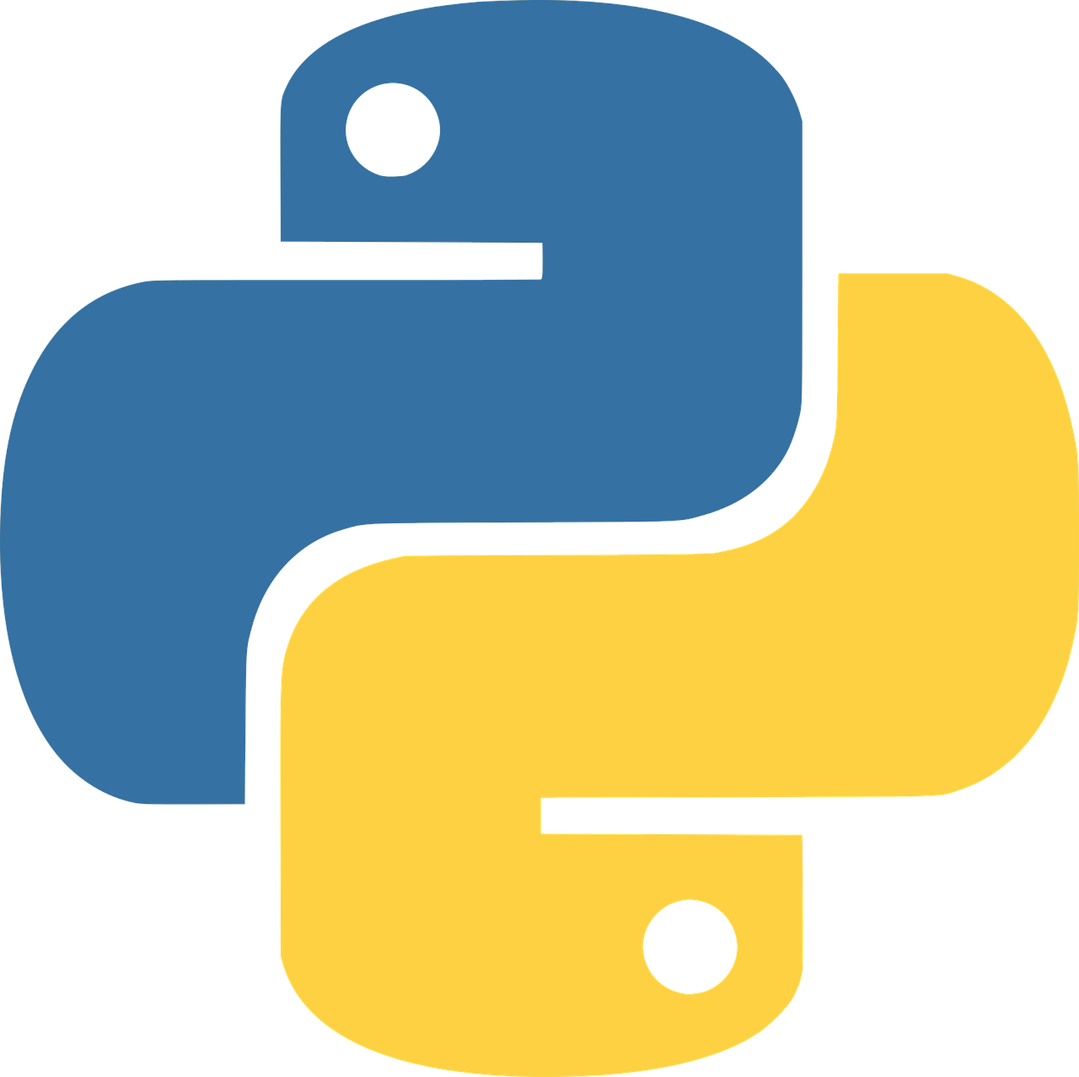
Intro to programming using
Python
Life Choices Coding Academy 2020

Slide 2
Learning Outcome:
By the end of the lesson, you should be able to:
Perform a fresh Install of the latest Python (3.8.1).
Have a basic usage and understanding of the python interpreter.
Write basic python code/statement(s)
Notes:
You should be able to install the latest Python
Have a basic understanding of the interpreter. Show the learners the interpreter later on.
In computer science, an interpreter is a computer program that directly executes instructions written in a programming language without requiring them previously to have been compiled in a machine language program.

Slide 3
INTRO...
What is a computer program?
What is programming?
What do you use to develop a program?
Why so many languages?
Notes:
Computer program - simply put, it is a set of instructions for accomplishing a specific task.
The act of writing a programs is called programming.
As a developer/programmer/engineer, it is your task to write a set of instructions for completing a specific task.
You use a programming language to develop a program. To turn human thoughts into 1’s and 0’s that the computer understands.
Why so many? Because people keep creating them. Java originally designed for interactive television (handheld, set-top) - Python (emphasis on code readability))

Slide 4


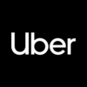
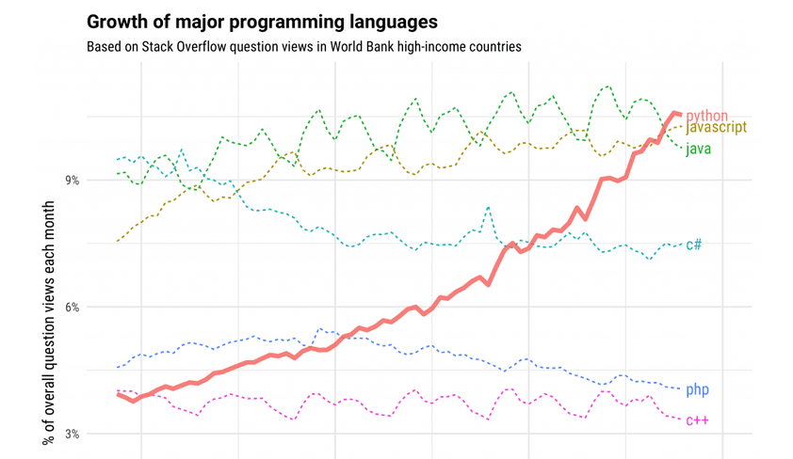

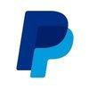


What is Python programming language?
Why Python?
Note on Python2 vs Python3 support.
Who uses Python
Notes:
What is Python - Python is an interpreted, high-level (user friendly), general purpose (wide variety of application domains) programming language. You can use Python for developing desktop GUI applications, websites and web applications, analyze data, automate operations via DevOps. Games etc.
Python program is read by a parser(Syntax analysis).
Python was designed to be a highly readable language.
Who uses Python? Lots of companies uses Python, click on the link, “who uses Python”
Investigate exactly what each company do with Python.
https://www.dummies.com/programming/python/what-is-python-and-what-can-you-do-with-it/
What is Python?
Multi-paradigm programming language
Interpreted language
Supports dynamic data type
Independent from platforms
Focused on development time
Simple and easy grammar
High-level internal object data types
Automatic memory management
It’s free (opensource)!
In space, the python is planned for use in a European mission to mars in 2020 to collect soil samples.

Slide 5
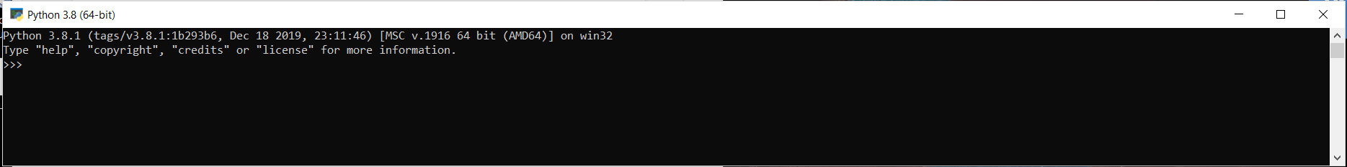
Installing python on windows machine
Download Python windows installer from our local repo.
Then follow the default installation instructions.
To open the Python interpreter, press the start button and search for Python
Open the file under the Best match.
Notes:
What do you need to start?
In our case because we use windows environment we will need to begin by installing the Python interpreter. If you were using a unix-based system (ubuntu or mac), you do not need to install the interpreter as it comes with the OS.
An interpreter is what is used to actually run your Python code. The interpreter, interpretes you code so that a computer can understand it.

Slide 6
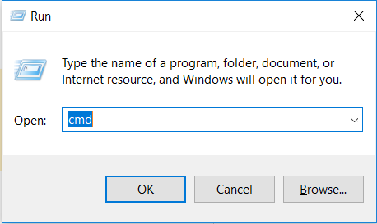
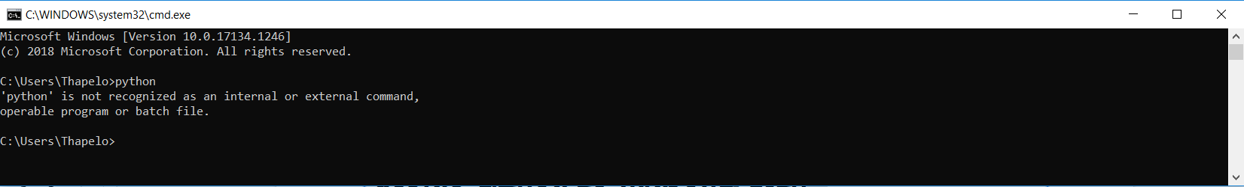
Alternative way to open the interpreter...
You can also open python interpreter by typing py in your command prompt.
Notes:
Mention that there are other ways you can open the interpreter depending on how python was installed.
Typing an end-of-file character (Control-D on Unix, Control-Z on Windows) at the command line causes the interpreter to exit with a zero exit status. If that doesn’t work, you can exit the interpreter by typing the following command: quit().
Remind the learners that, this is an interpreter and works a bit like a calculator.

Slide 7

Done Setting up Python
Notes:
Done setting up Python. Now let’s move on to writing some code.

Slide 8
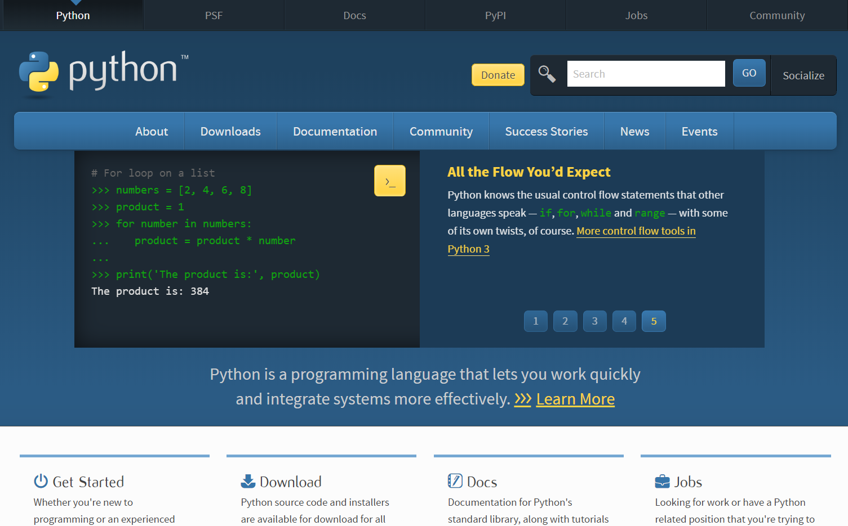
Official Documentation
Python Official Documentation Link
Notes:
This is the Python official page for documentation. When you get stuck anywhere or you are looking for a more detailed discussion about python, you can always consult the documentation.
For an in-depth reading with regard to any of python modules, functions etc, read the docs.
https://blog.finxter.com/python-cheat-sheet/

Slide 9
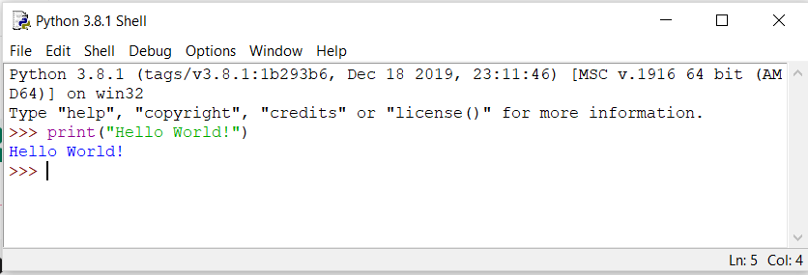
Hello World Program:
Notes:
Can you please type your first Python code in the interpreter?
After you are done, you can hit enter and your code will be run through the interpreter.
You have written your first code in Python, well done!!!
So, you have just observed how your python code got executed by the interpreter.
Now let’s get to leaning python syntax first.

Slide 10
Python Syntax
Python line structure
Comments in Python
Joining two lines
Indentation
Python coding style
Python reserved words
Notes:
Coding is like a language (English, Afrikaans, IsiXhosa) each programming language has its own rules. In Python we have that set of rules syntax and we will be exploring what a syntax is.
Python was designed with readability in mind, and has some similarities to the English language with influence from mathematics.
Python uses new lines to complete a command, as opposed to other programming languages which often use semicolons or parentheses.
Python relies on indentation, using whitespace, to define scope; such as the scope of loops, functions and classes.
Comments can be used to explain Python code.
Comments can be used to make code more readable
Comments can be used to prevent execution when testing.

Slide 11
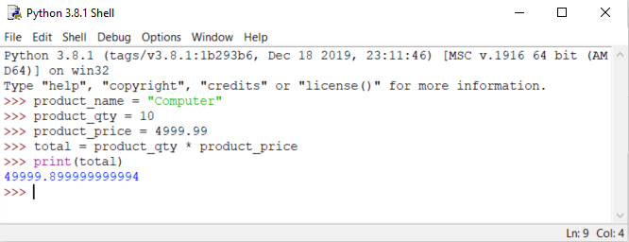
Python Variable
In Python a variable is a container used to store a value.
There is no command for declaring python variable.
Notes:
Demonstrate how other programming languages declare variable.

Slide 12
Good variable Name
Choose meaningful name instead of short name. roll_no is better than rn.
Maintain the length of a variable name. roll_no_of_a_student is too long
Be consistent; roll_no or rollNo
Begin a variable name with an underscore(_) character for a special case
Notes:
Mention that naming a variable is important when you are working in a big project. Consider how will you search for a variable in a large code base.

Slide 13
Python Assignment Statements
Creates new variables and gives them the values
Multiple Assignment
Assign many values at the same time
Reuse variable names by assigning a new value to them
Notes:
Demonstrate multiple assignment in the interpreter .

Slide 14
Exercise time :)

